Slide 1

Intelligent and Weather Adaptive Street Lighting System AE-16
TEAM MEMBERS
NAME ROLL
AKASH ARYAN 523
SHOURYA 553
NITIN KUMAR 538
SHUBHAM KUMAR 518
VAIBHAV KUMAR 513

Slide 2
INTRODUCTION
The street lighting is one of the largest energy expenses for a city. AN intelligent street lighting system can cut municipal street lighting costs as much as 50%-70%.
An intelligent street lighting system is a system that adjusts light output based on usage and occupancy, i.e., automating classification of pedestrian versus cyclist, versus automotive.
An intelligent street light management proposes the installation of the wireless based system to control the actual energy consumption of the street lights and take appropriate energy consumption reduction measures through power conditioning an

Slide 3
PROBLEM STATEMENT
We have found within the urban communities where the street lights are one of the immense vitality costs for a city. We have a manual framework where the lights will turn ON before dusk and will turn OFF the following morning after adequate light is outside. So there is a parcel of vitality waste among ON and OFF planning. Delayed reports of faulty street lights condition and their diagnostic.

Slide 4
Agenda
1.components
2.circuit diagram
3.code
4.screenshots
5.references

Slide 5
1. Components
NAME` | Quantity
ESP8266 Node MCU | 1
IR Sensors | 3
LED | 3
LDR Sensor | 1
Resistors(1k ohm) | 3
Jumper Wires

Slide 6
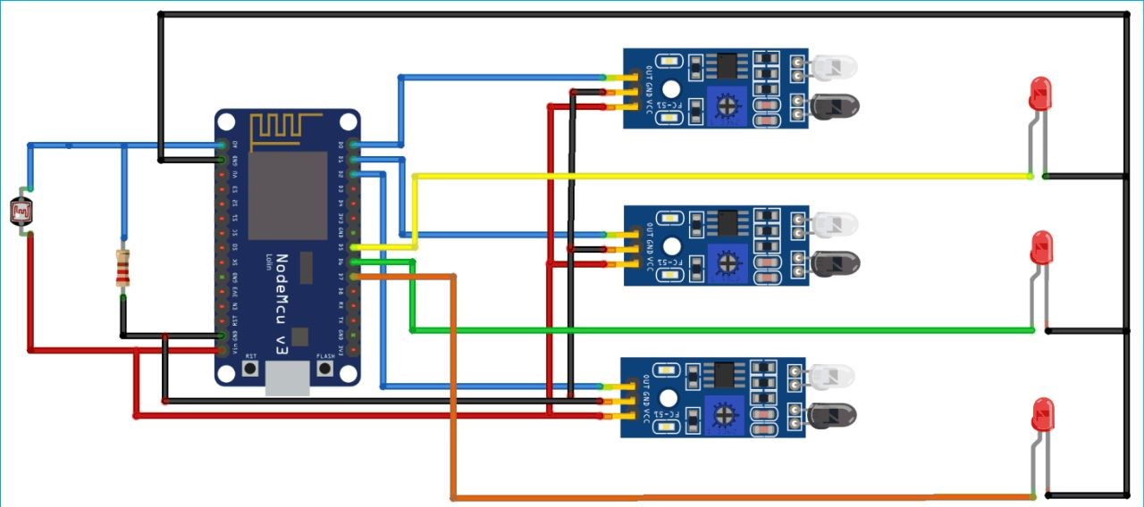
Smart Street Lighting System

Slide 7
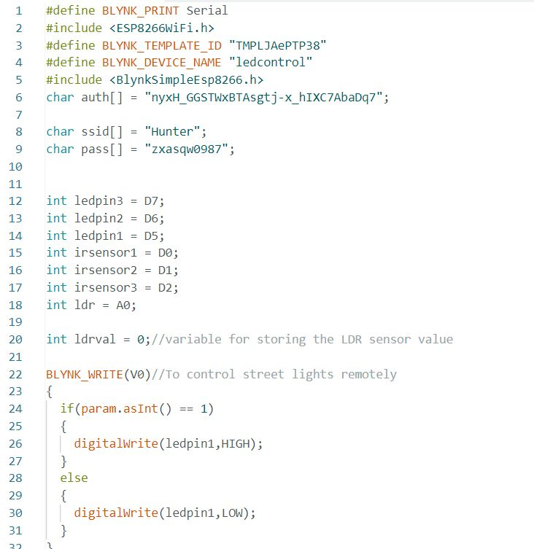
3. Code

Slide 8
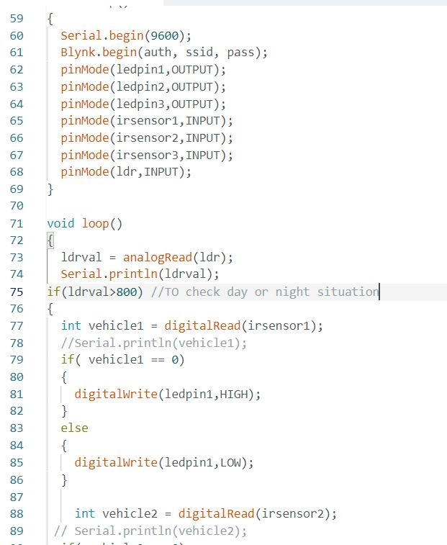
3. Code

Slide 9
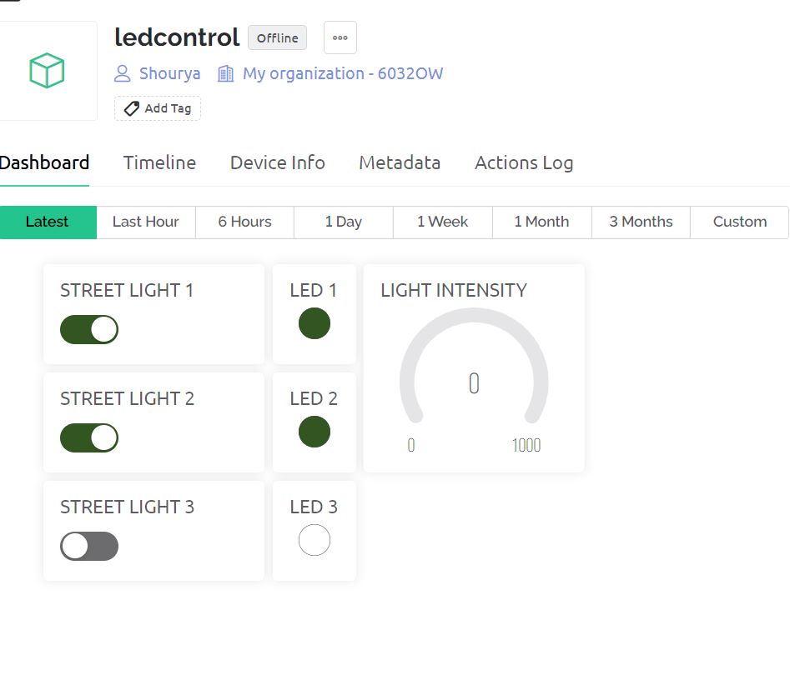
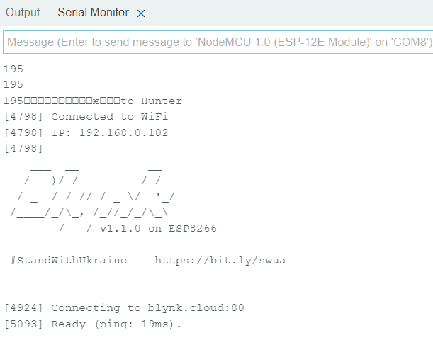
Dashboard For Smart Street Lighting

Slide 10
References
https://docs.blynk.io/en/getting-started/template-quick-setup/set-up-mobile-app- dashboard
https://docs.blynk.io/en/blynk.edgent-firmware-api/blynk-timer
https://randomnerdtutorials.com/esp8266-pinout-reference-gpios/
https://docs.blynk.io/en/getting-started/using-virtual-pins-to-control-physical-devices
https://www.youtube.com/watch?v=FbbTKxITW6E&t=438s
https://www.youtube.com/watch?v=g1mk-UGgWGU
https://docs.blynk.io/en/blynk.apps/widgets-app

Slide 11
Thank you

